Slide 1
Summer Project
SnT Council
IIT Kanpur
BCS
Speech Emotion Recognition

Slide 2
Contents
Aim
Roadmap
Week 1
Week 2
Week 3
Week 4

Slide 3
Aim:
The aim of this project is to build and compare MLP, LSTM and CNN Model for speech emotion recognition using RAVDESS Audio dataset.

Slide 4
Roadmap:
Week 1: Covered ML/DL basics and an assignment
Week 2: Built Audio recorder, plotted waveform and spectrogram, learnt Audio preprocessing for features extraction.
Week 3: Implemented the code for feature(Spectrogram, MFCC) extraction using Librosa Library.
Week 4: Implemented the MLP model for emotion and gender recognition and evaluated it on test set.

Slide 5
Week-1

Slide 6
1.Went through the Python tutorial For the BCS workshop Apr’20 and got familiar with Python. (link)
2.Got introduced to ML, Basics CV with ML, Introduction to CNN and Built an Image Classifier(Rock, Paper, Scissor) by going through videos by Lawrence Moroney, AI advocate at google. (link)
3.Got introduced to Deep learning by Alexander Amini. (link)

Slide 7
Assignment :
The assignment contained two questions based on Machine learning and Deep learning.
1st part included building a linear regression model by the method of Gradient Descent and the 2nd part included building a fully connected CNN model in Tensorflow using deep learning.
https://colab.research.google.com/drive/1YvchsRxfQ7hwl4FLLmKvvW4Atc4bMdkC#scrollTo=wq1ZliSEuhTw

Slide 8
Week-2

Slide 9
Visualizing Audio :
For visualization of audio, we plotted the following graphs using librosa library.
WavePlot : Graphic representation of the shape of a wave that indicates its characteristics. In short, it’s an Amplitude vs Time graph.
Spectrogram : It is a visual representation of the spectrum of frequencies of a signal as it varies with time.
MFCC : Mel-Frequency Cepstrum (MFC) is a representation of the short-term power spectrum of a sound. Mel-frequency cepstral coefficients (MFCCs) are coefficients that collectively make up an MFC.

Slide 10
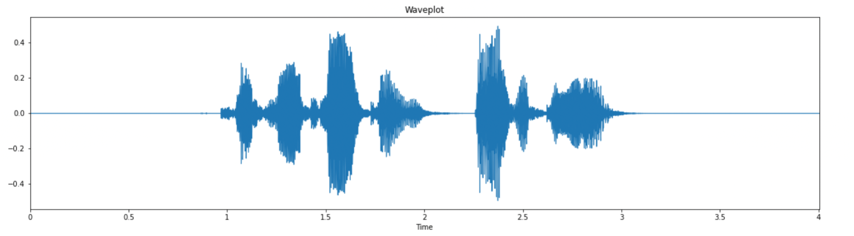
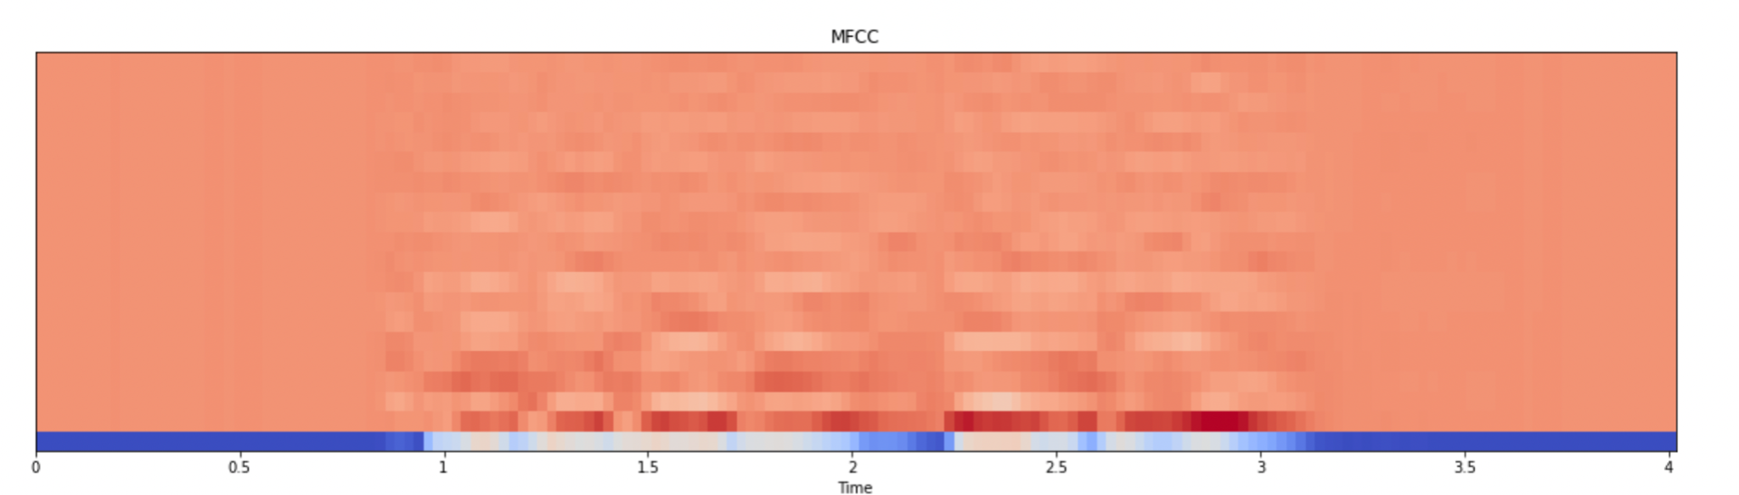
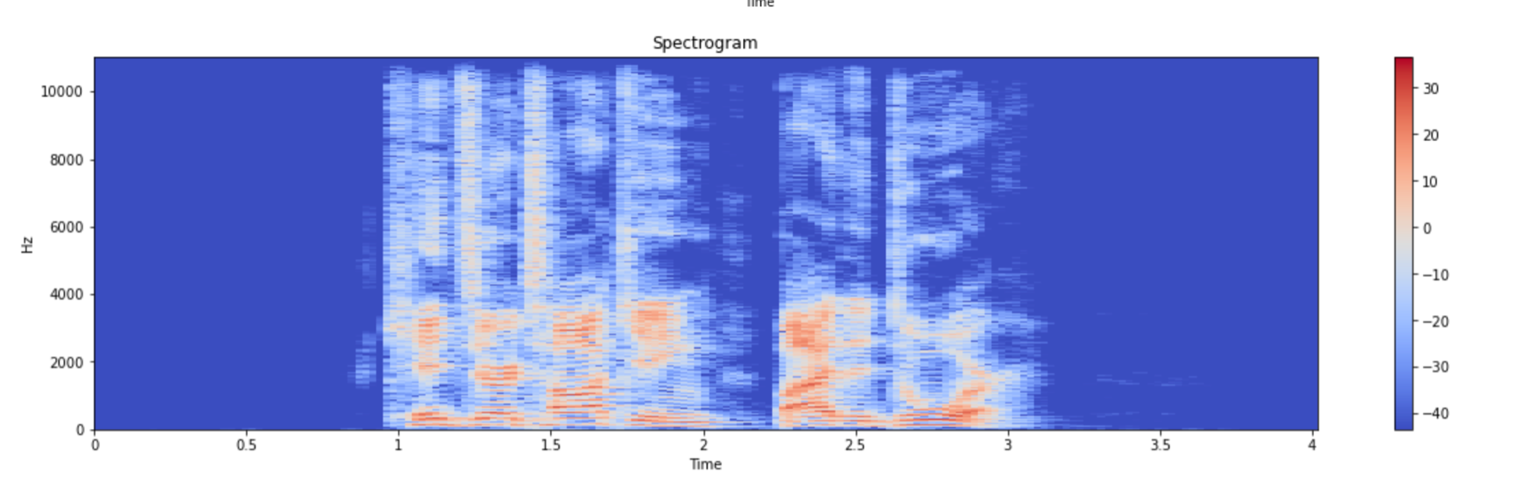

Slide 11
What is Feature extraction ?
Feature extraction is very effective in increasing the accuracy and efficiency of machine learning algorithms in emotional speech recognition.
The input audio file is reduced to a set of features which represent or summarise the original input.
The extracted features are then fed into the neural network model to identify the respective emotion.
The main feature we have extracted and used for training our model is MFCCs.

Slide 12
Week-3

Slide 13
Implementation details :
The objective of this project is to classify the sound files into gender and emotion labels.
Two separate models are used. One for classifying gender and another for classifying the emotion.
Both the models have identical implementation besides the fact that in case of emotion there are 8 labels(one hot encoded) and in case of gender classification only 2 labels(one hot encoded).

Slide 14
Taking Inputs :
We used the RAVDESS emotional speech dataset.
There are 1440 files (60*24 Actors) available in the dataset. Each file is approximately of 3 sec length.
The filename are such that numbers after ‘-’ define the labels such as gender, emotion, actor. E.g. - 03-01-06-01-02-01-12.wav
In filename, the third number represents the emotion and if actor number (last number) is even then female and male if odd.
Each filename is stored in a pandas dataframe along with their emotion, gender and actor.
This dataframe is further used to load each audio file.

Slide 15
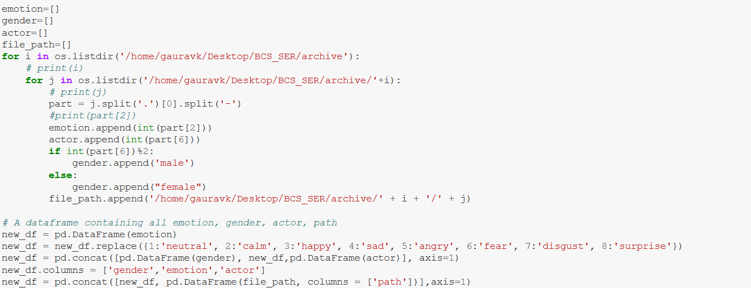

Slide 16
Feature Extraction :
MFCCs features are extracted from the sound files. Generally, librosa.feature.mfcc returns us the mfcc of each audio file and is of shape 20x143. (20 represents 20 features in MFCC.)
Each Audio file generates 20x143 MFCC matrix, we take mean in each row and get 20 MFCCs values for each audio file, these 20 values represents one audio file.
Finally we have 1440 audio files so we get 1440 x 20 as our X and there are 1440 audio files so we get total ((1440,),(20,)) total as our dataset.
As we are training on mfccs values so that acts as X(input parameter) based on its corresponding emotions values so this will act as Y(output parameter).
After that we divide train and test data in 0.7 : 0.3 ratio and at last we normalize the data for before further Processing.

Slide 17
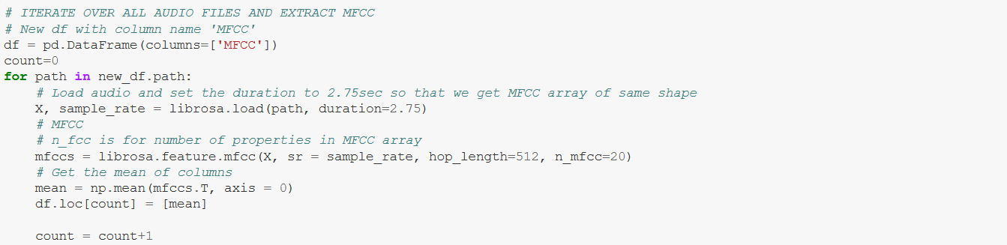
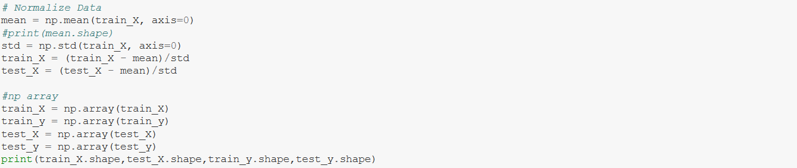

Slide 18
Week-4

Slide 19
MLP Model Architecture:
A fully connected neural network is deployed to predict the emotions from the features of the sound files.
The model consists of 4 hidden layers with a dropout of 0.1 in the first three layers.
The 1st and the 2nd hidden layer consists of 512 neurons while the 3rd layer contains 128 neurons and the 4th hidden layer contains 64 neurons.
The model is defined using Keras inbuilt module Sequential which takes input in the form of layers.
“relu” activation function is used to calculate the values of parameters from one layer to another layer.

Slide 20
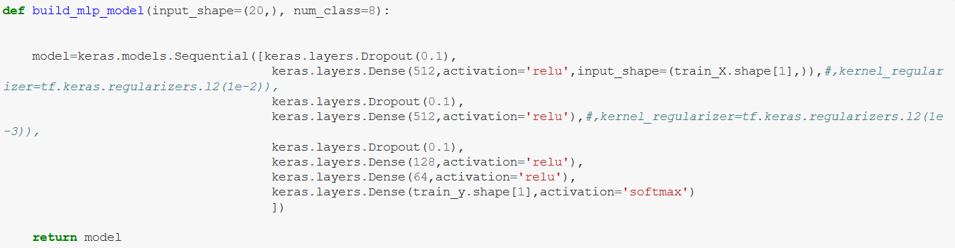
The input layer is of the shape (20,) and the output layer predicts the emotion using the “softmax” which gives the probability of each label and the layer with the highest probability is selected and given as the answer.

Slide 21
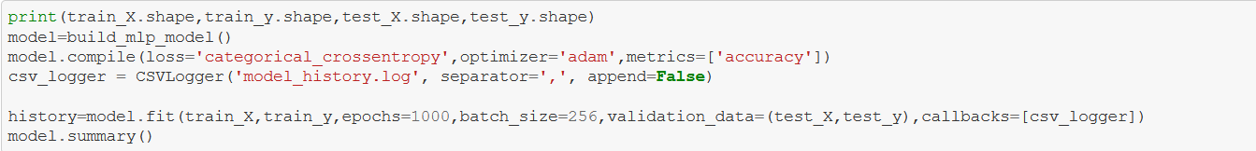
Model training and Processing:
After the feature extraction process, the data is divided into training and testing data with a test size of 0.3.
“Categorical_crossentropy” is used to calculate the loss and “adam” optimizer is used in the final compilation of the trained model.

Slide 22
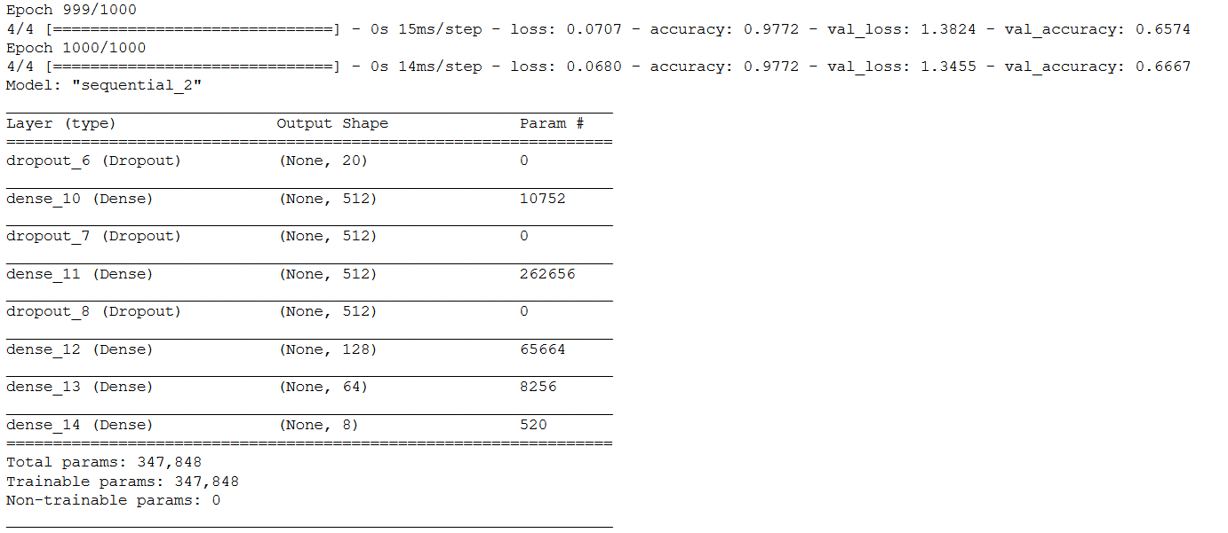
Model Summary

Slide 23
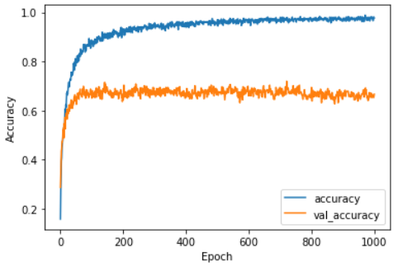
Results :
Emotion recognition
Accuracy obtained on training data is 97.72%.
Accuracy obtained on testing data is 66.677%.

Slide 24
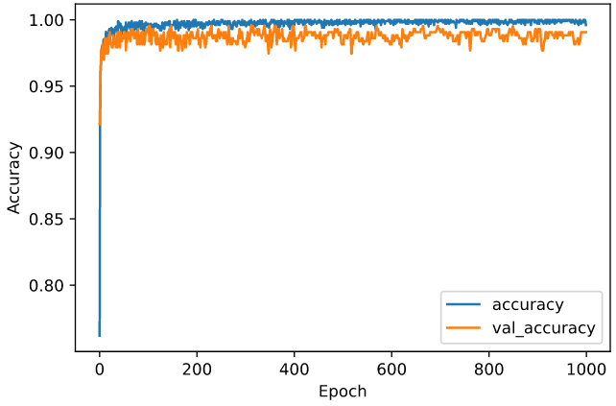
2. Gender recognition :
Accuracy obtained on training data is 99.6%.
Accuracy obtained on testing data is 99.07%.

Slide 25
Project
Link
https://github.com/Gaukm01/BCS_SER_project

Slide 26
WORK REMAINING
In further weeks, we will try to improve the model accuracy through CNN and LSTM model.
A comparison will be made, to which model is best for the Speech Emotion Recognition.

Slide 27
Team members and contributions :
All the Team Members :
Akash Kumar Bhoi Ankit Yadav
Gaurav Kumar Gulshan Kumar
Harsh Patel Tarun Agarwal
Contribution to each part of project:
Assignment : Done by everyone individually.
Plotting : Harsh
Feature Extraction : Gaurav, Harsh
Data Division and Pre-Processing : Gaurav, Harsh
MLP Model framework : Akash, Ankit, Gulshan
MLP Model implementation : Gaurav, Harsh, Ankit, Akash
Documentation : Harsh, Gaurav
PPT : Gulshan, Ankit, Akash, Tarun

Slide 28
THANK YOU

